Slide 1

Strengthening Mechanisms
Dr. J. Venkatramani
219-B
venkatramani@iiitdm.ac.in

Slide 2
Dislocation motion – Plastic Deformation
Large scale movement of dislocations is the microscopic cause behind plastic deformation in most of the metals.
“Arresting these dislocations” prevents plastic deformation so that, the yield strength of the metal increases.
Higher the dislocation density lesser mobility for the dislocations and hence, the material becomes stronger.
Grain boundaries act as obstacles to dislocation motion. Thus, they too strengthen the materials.
Presence of impurities will strengthen the materials by hindering dislocation motion.

Slide 3
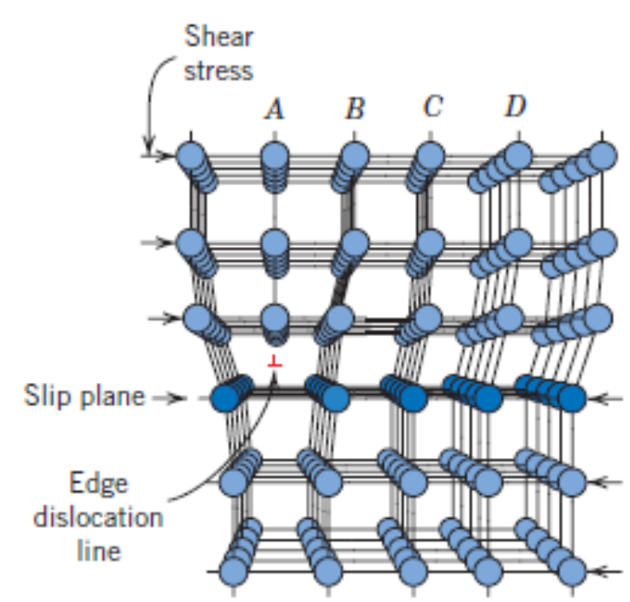
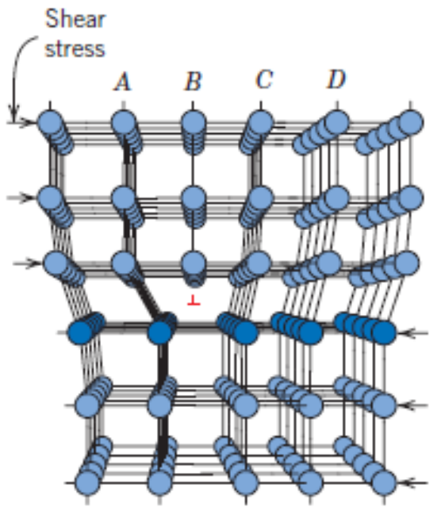
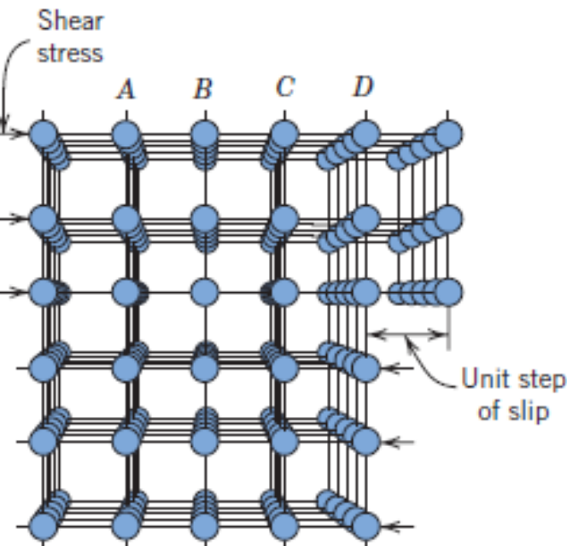
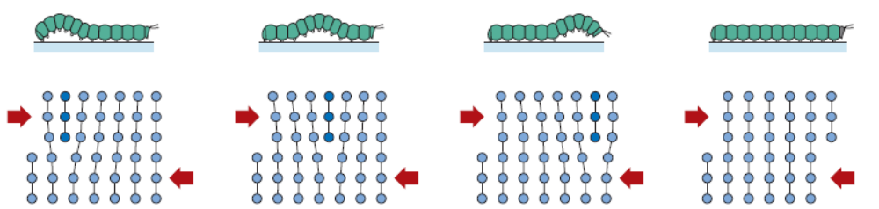
Dislocation motion – Plastic Deformation
Dislocation motion – Plastic Deformation

Slide 4
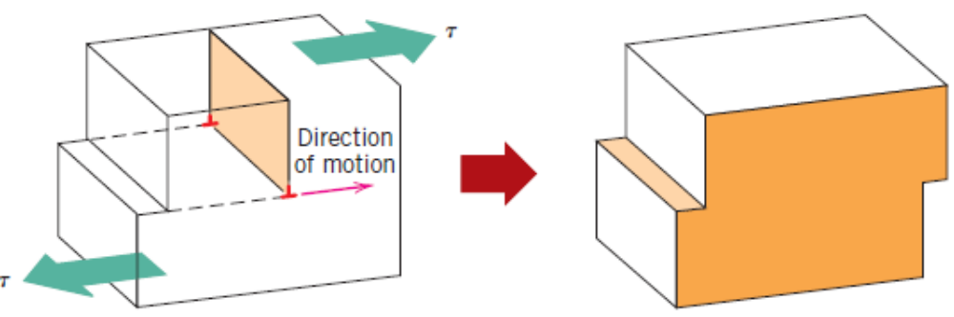
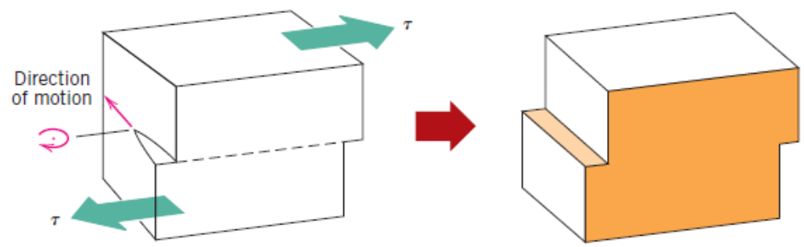
Dislocation motion – Plastic Deformation
Dislocation motion – Edge Vs Screw Dislocation

Slide 5
Dislocation motion – Plastic Deformation
Dislocation Density: Number of dislocations per unit area intercepted by the dislocations
or
Length of the dislocation line per unit volume
For metals cast by controlled solidification, the dislocation density is in the order of 10³/mm².
For heavily processed metals, it can be as high as 10⁹ to 10¹⁰ mm^{–2}. A further treatment of these metals may reduce the dislocation densities to an order of 10⁵ to 10⁶ mm^{–2}.
For ceramic materials, this number lies in the range 10² to 10⁴ mm^{–2}.
For single silicon crystals used in integrated circuits, it is in the range 0.1 to 1 mm^{–2}.

Slide 6
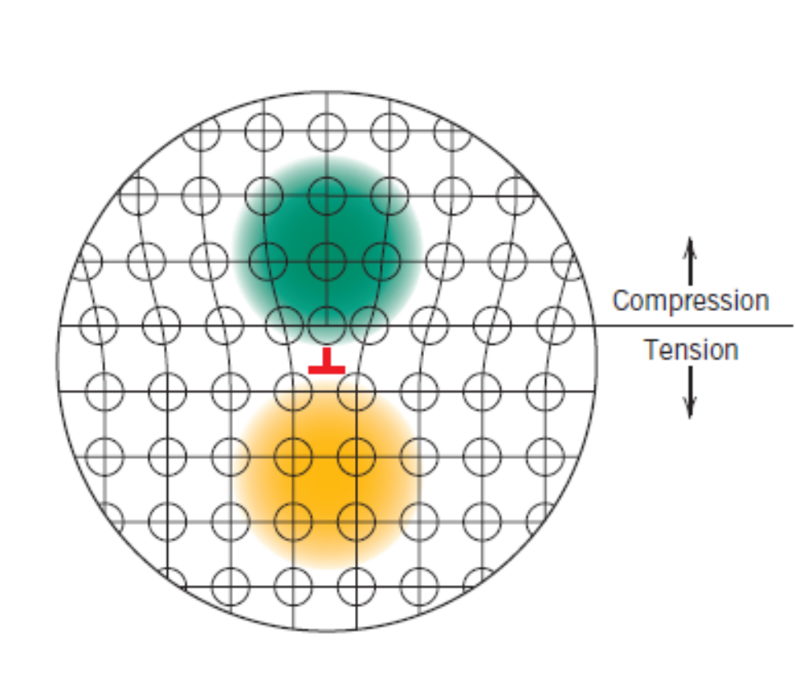
Strains around dislocations – Dislocation motion
In an edge dislocation, the atoms beside the extra half–plane feel repulsion between each other. Hence, compressive strains are induced. With a similar argument, one may conclude that tensile strains exist in the region below the extra half–plane.
In a screw–dislocation case, the strains are purely shear type.
These strains around dislocations of close proximity will interact with each other such that forces are imposed on each dislocation by all the neighbouring dislocations.

Slide 7
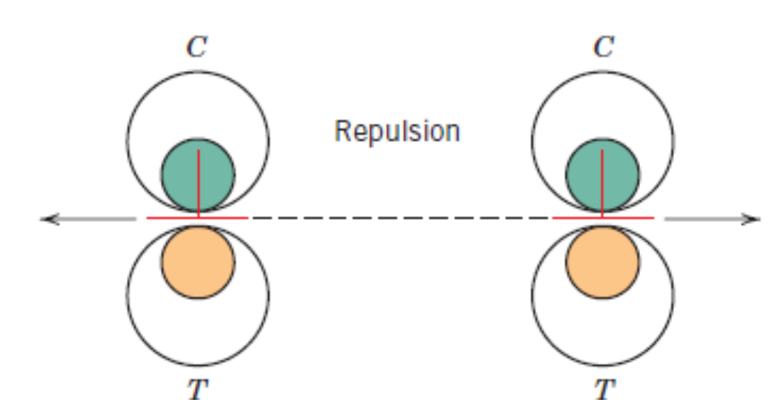
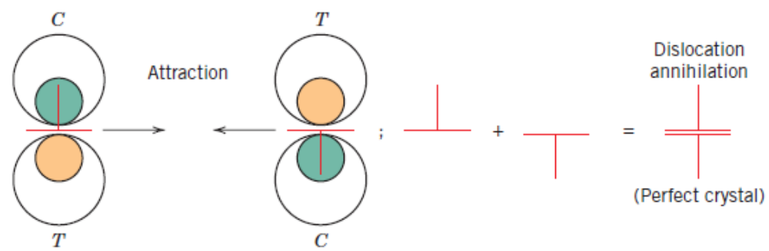
Strains around dislocations – Dislocation motion
Dislocations of same type (same sign) on the same slip plane repel each other.
Whereas, the dislocations of opposite type attract each other and annihilate to combine and form a perfect crystal.
Upon severe deformation, dislocations multiply causing increase in dislocation density. Further, the grain boundaries, internal defects, surface irregularities also act as source of dislocation nucleation.

Slide 8
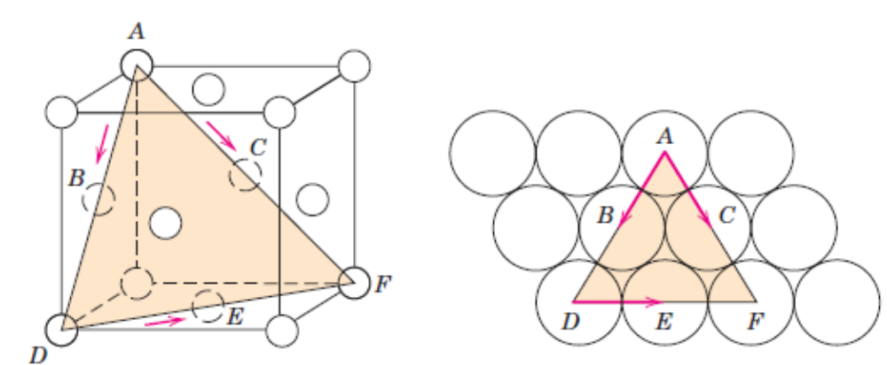
Slip Systems
Dislocations do not move with the same degree of ease on all crystallographic planes.
The preferred planes on which slip occurs are called slip planes. And, the direction in which slip occurs is called slip direction. The combination of a slip plane and a slip direction is called a slip system.
Slip system depends on the crystal structure and will be such that the atomic distortion caused by slipping of a dislocation is minimum. For a given crystal structure, the slip plane is the one that has highest planar density and the slip direction is the direction on this slip plane, along which the atoms are closest packed, highest linear density.
Example: FCC
Slip planes – {111}
Slip directions – <110>
Slip systems – {111}<110>

Slide 9
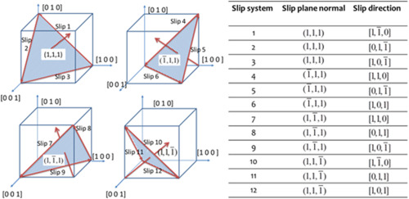
Slip Systems
12 independent slip systems for FCC Crystal structure.

Slide 10
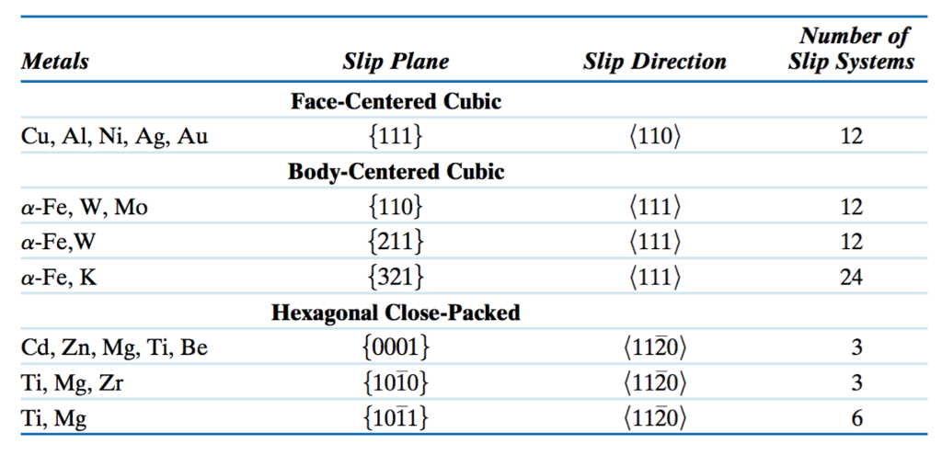
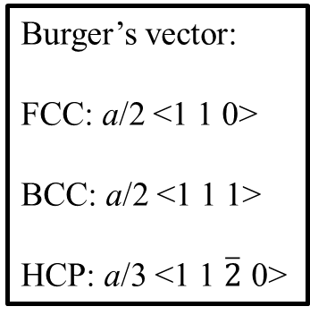
Slip Systems
Independent slip systems for FCC, BCC and HCP Crystal structures.
Burger’s vector:
FCC: a/2 <1 1 0>
BCC: a/2 <1 1 1>
HCP: a/3 <1 1 $\overline{2}$ 0>

Slide 11
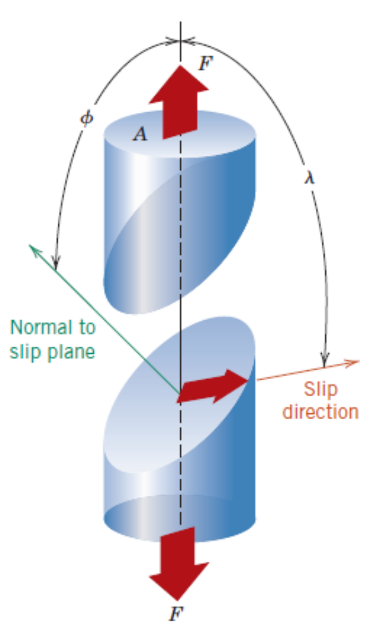
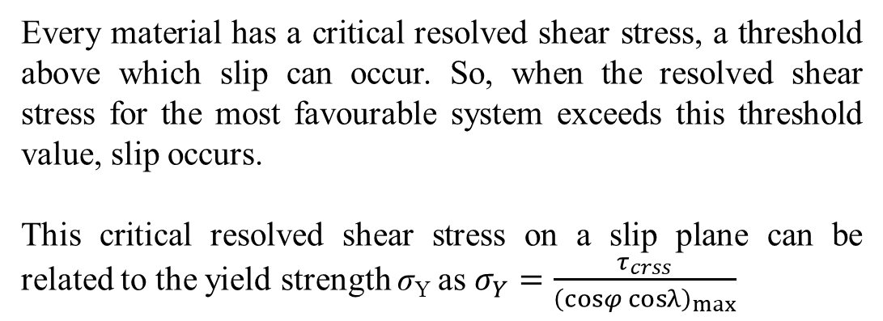
Slip in Single Crystals
Resolved shear stress
What is the resolved shear stress for different slip systems in a FCC crystal when F is applied along [0 0 1]?
The system that has the maximum resolved shear stress is the most favourable slip system.
Every material has a critical resolved shear stress, a threshold above which slip can occur. So, when the resolved shear stress for the most favourable system exceeds this threshold value, slip occurs.
This critical resolved shear stress on a slip plane can be related to the yield strength σ_{Y} as $σ_{Y}=\frac{τ_{crss}}{{\left(cosφ cosλ\right)}_{max}}$

Slide 12
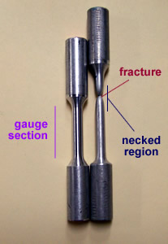
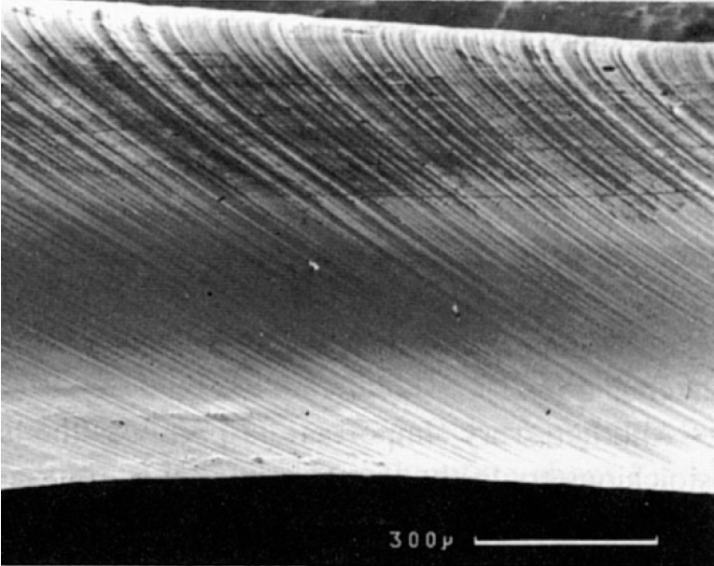
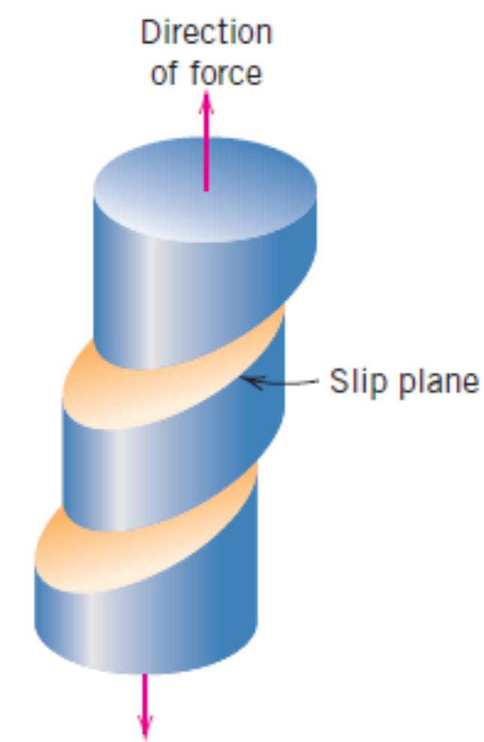
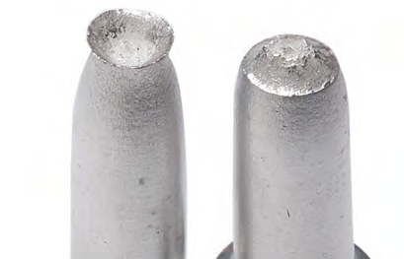
Slip in Single Crystals
Slip lines seen on the surface of a deformed thin metallic wire

Slide 13
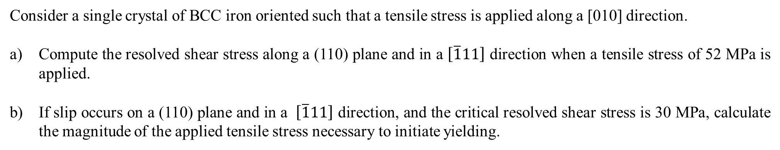
Slip in Single Crystals
Consider a single crystal of BCC iron oriented such that a tensile stress is applied along a [010] direction.
Compute the resolved shear stress along a (110) plane and in a $\left[\overline{1}11\right]$ direction when a tensile stress of 52 MPa is applied.
If slip occurs on a (110) plane and in a $\left[\overline{1}11\right]$ direction, and the critical resolved shear stress is 30 MPa, calculate the magnitude of the applied tensile stress necessary to initiate yielding.

Slide 14
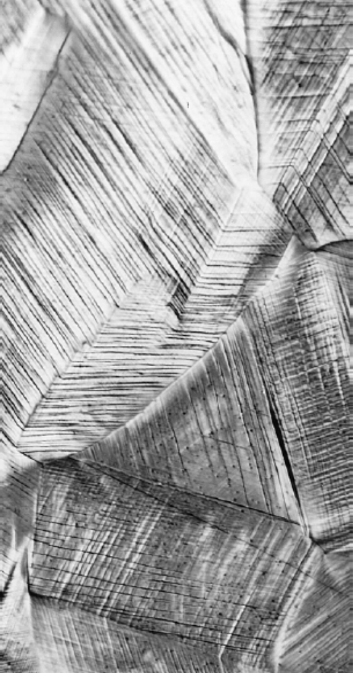
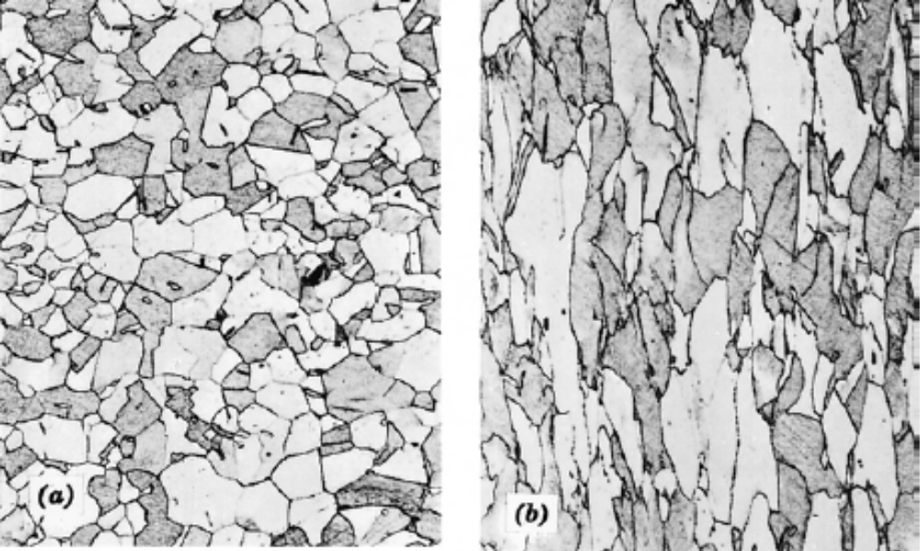
Plastic Deformation in Polycrystalline Materials
Micrographs showing how initially equi–axed grains become directionally oriented due to elongation along a particular direction
Polycrystalline materials are stronger than their single–crystal equivalents. Why?
Slip lines on the surface of a polycrystalline copper specimen

Slide 15
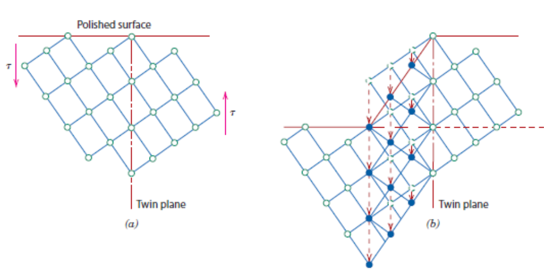
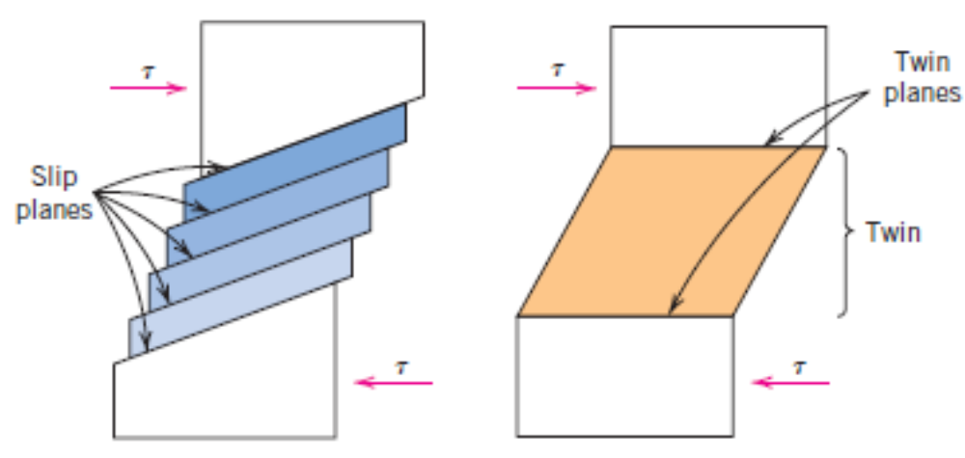
Plastic Deformation by twinning
Deformation by formation of mechanical twins. The twin plane about which twinning occurs depends on crystal structure.
Low temperatures and higher rates of loading.
The amount of bulk plastic deformation through twinning is small compared to slip.
Twin Vs Slip Comparison

Slide 16
Strengthening Mechanisms in Metals
“Restricting or hindering dislocation motion renders a material harder and stronger”
Grain size reduction
Solid – Solution Strengthening
Strain Hardening

Slide 17
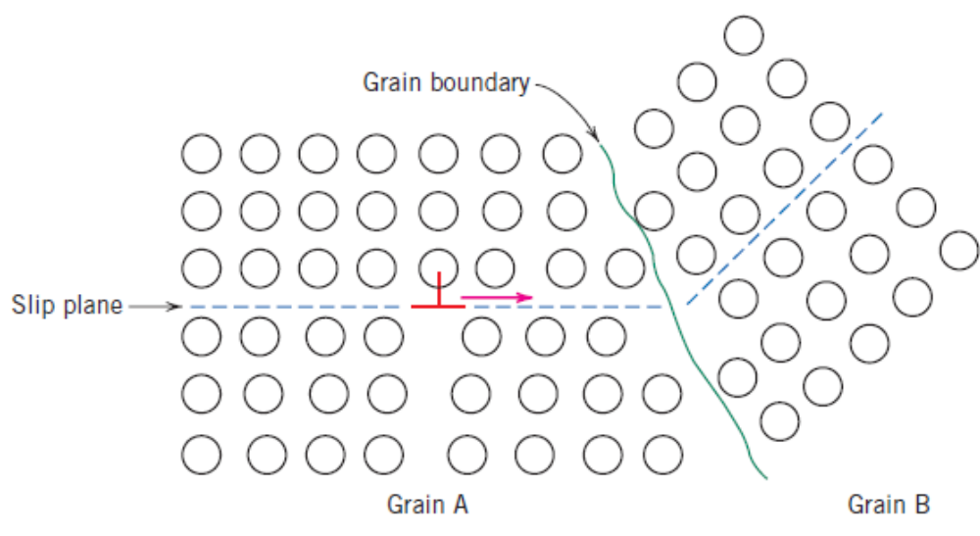
Strengthening Mechanisms in Metals – Grain size reduction
Grain boundary is a discontinuity in atomic order.
The direction and plane of dislocation motion has to change.
As a result grain boundary acts as an obstacle to dislocation motion.
The dislocations tend to pile up at the high–angle grain boundaries
Smaller the grains are in a polycrystalline material, higher the grain boundary area. Hence, a fine–grained material is harder and stronger.

Slide 18
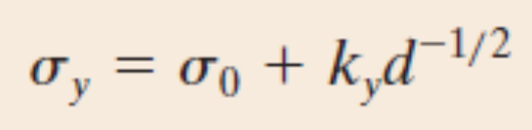
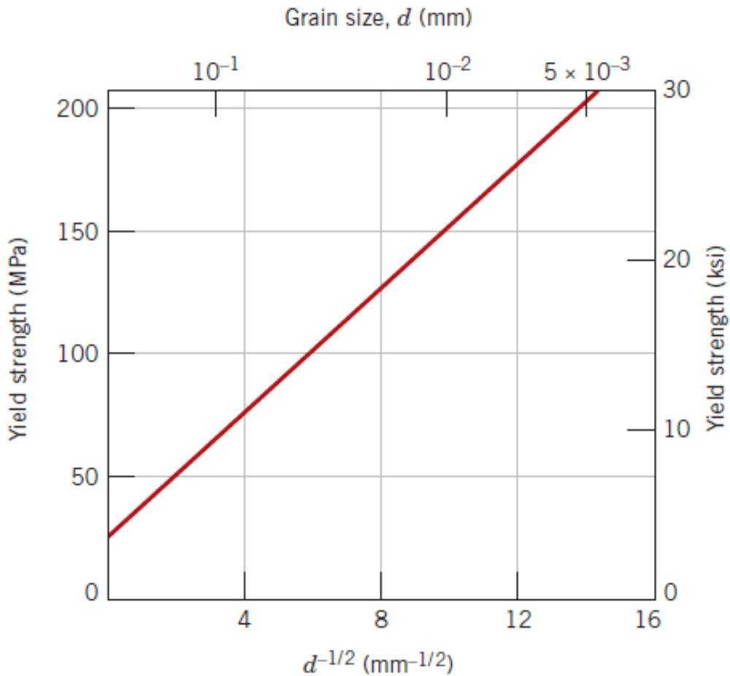
Strengthening Mechanisms in Metals – Grain size reduction
Yield Strength Variation With Grain Size: Hall – Petch relation
d is the average grain size.
σ₀ and d are constants for a particular material.
Small angle grain boundaries are not as effective in hindering the slipping process.
Twin boundaries, again, can block the dislocation motion.
For more complex alloys, phase boundaries act as obstacles to dislocation motion.

Slide 19
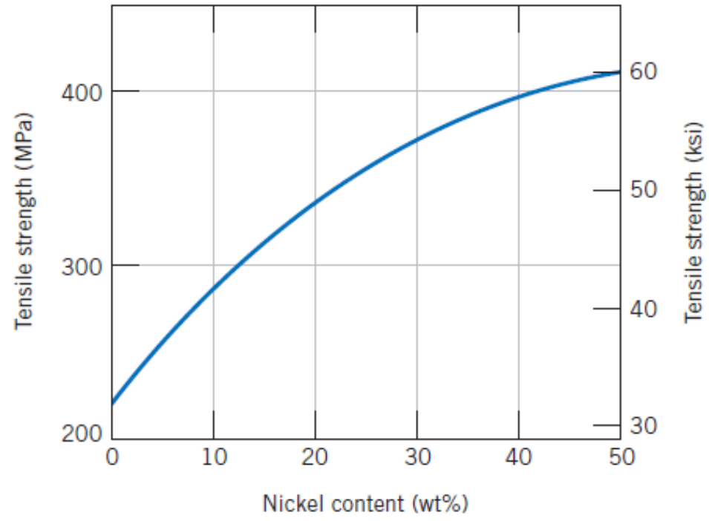
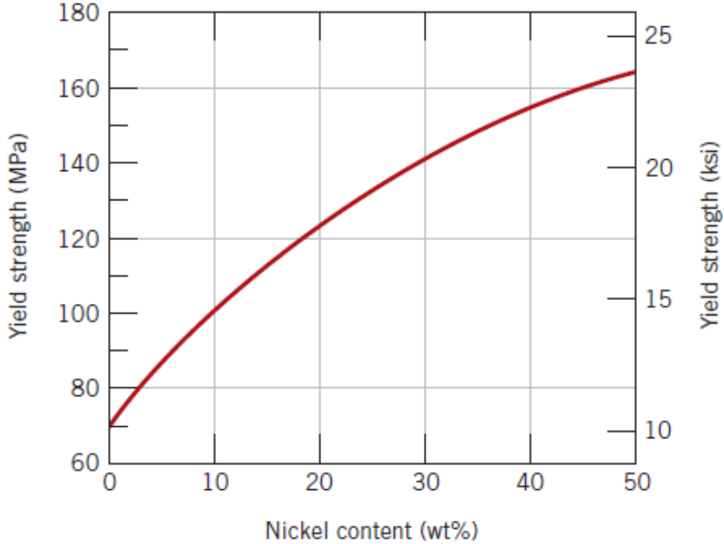
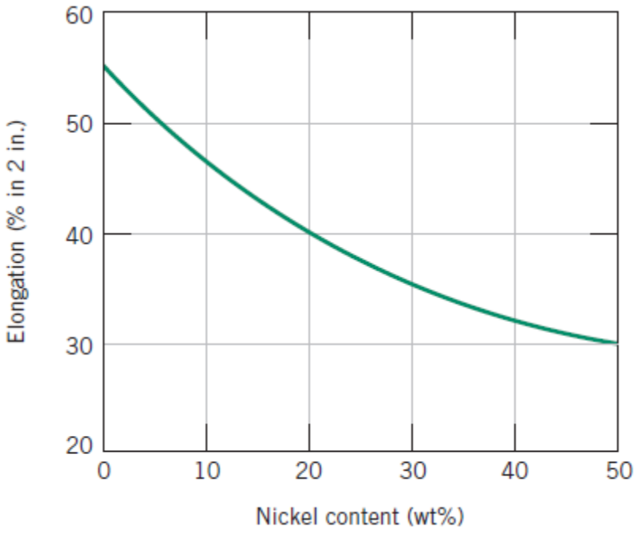
Strengthening Mechanisms in Metals – Solid Solution Strengthening
Substitutional or interstitial impurity atoms act as obstacles to dislocation motion. This phenomenon is called Solid–Solution strengthening.

Slide 20
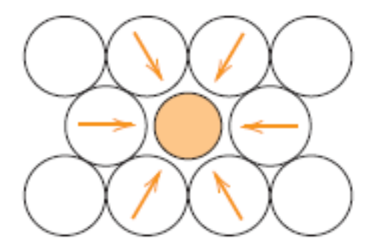
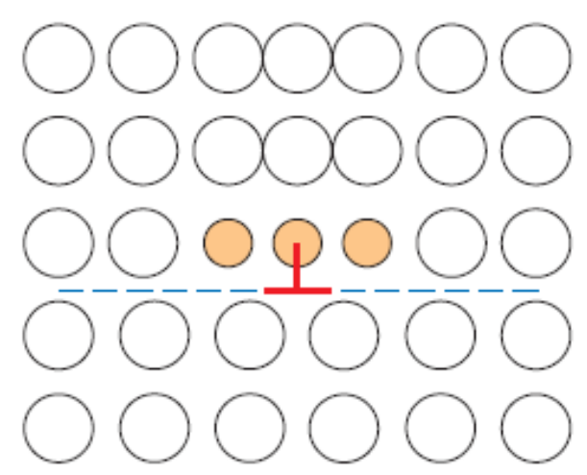
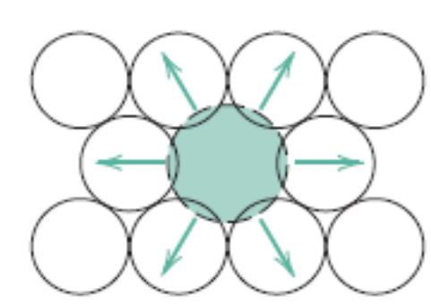
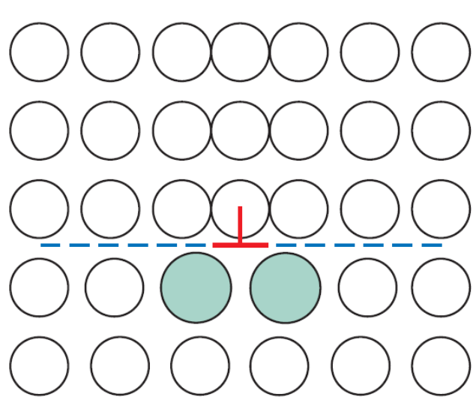
Strengthening Mechanisms in Metals – Solid Solution Strengthening
Tensile strains due to smaller substitutional atoms interact the with compressive strains of a dislocation, restricting further motion of the dislocation.
Tensile strains induced in the case where, a smaller atom “substitutes” a parent atom.
Compressive strains due to bigger substitutional atoms interact the with tensile strains of a dislocation, restricting further motion of the dislocation.
Compressive strains induced in the case where, a bigger atom “substitutes” a parent atom.

Slide 21
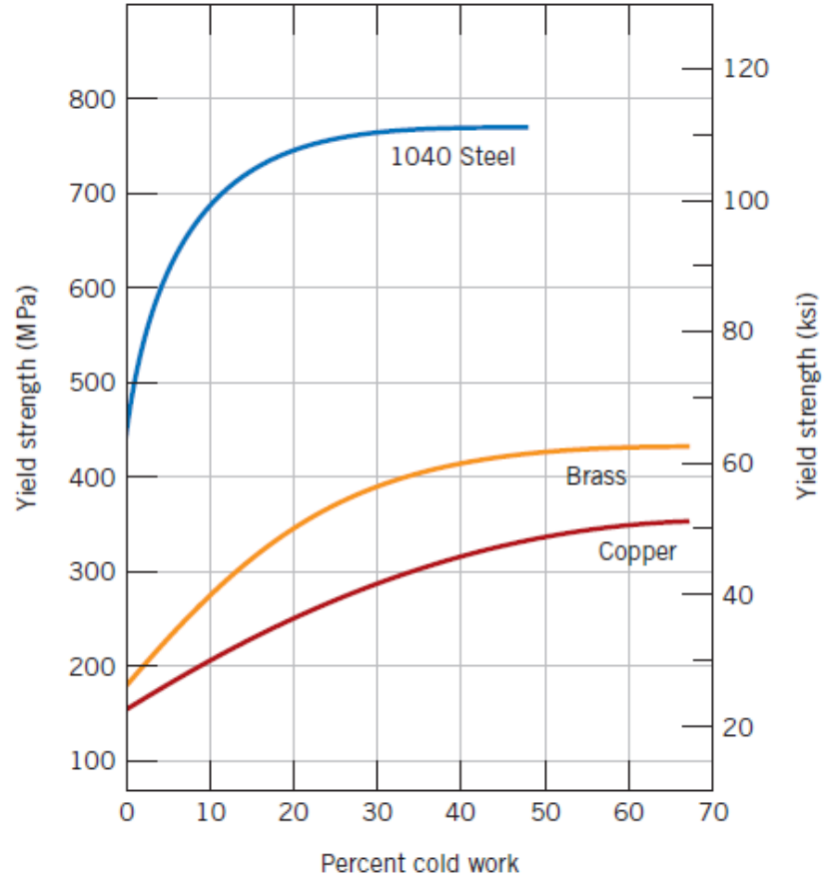
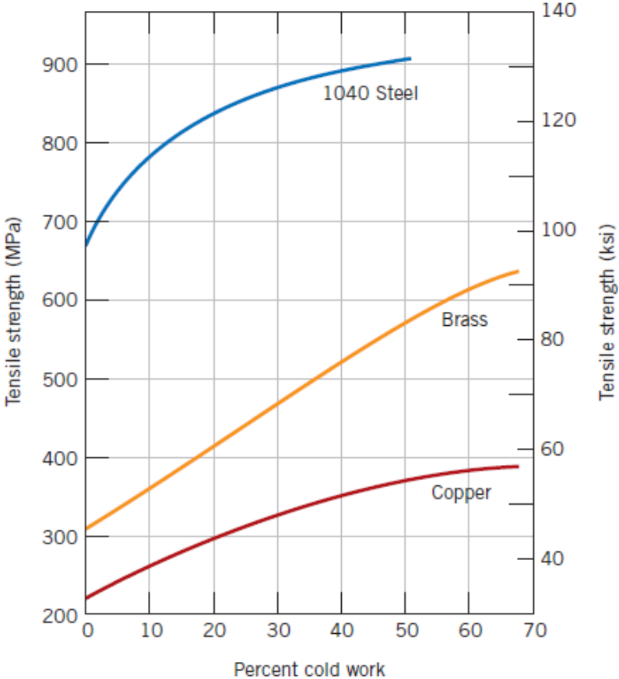
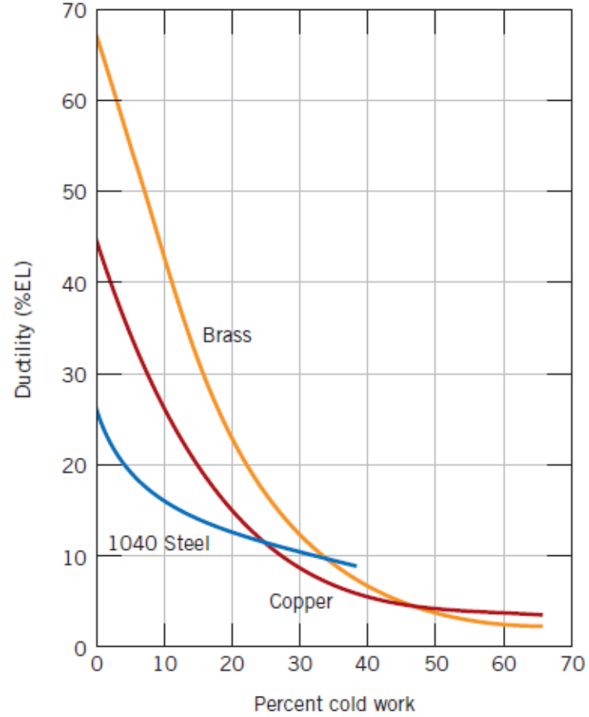

Strengthening Mechanisms in Metals – Strain Hardening
Also called “Work Hardening” or “Cold Working”.
% Cold Working = $\frac{A_{0}−A_{d}}{A_{0}}X 100$

Slide 22
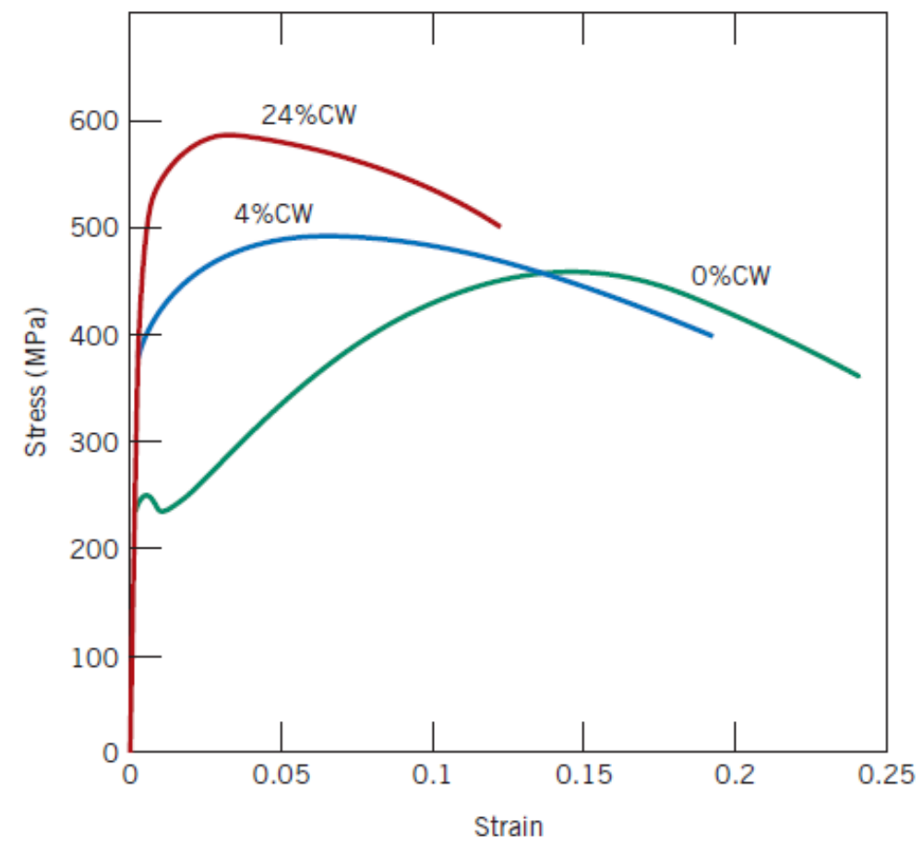
Strengthening Mechanisms in Metals – Strain Hardening
Cold working in low carbon steel

Slide 23
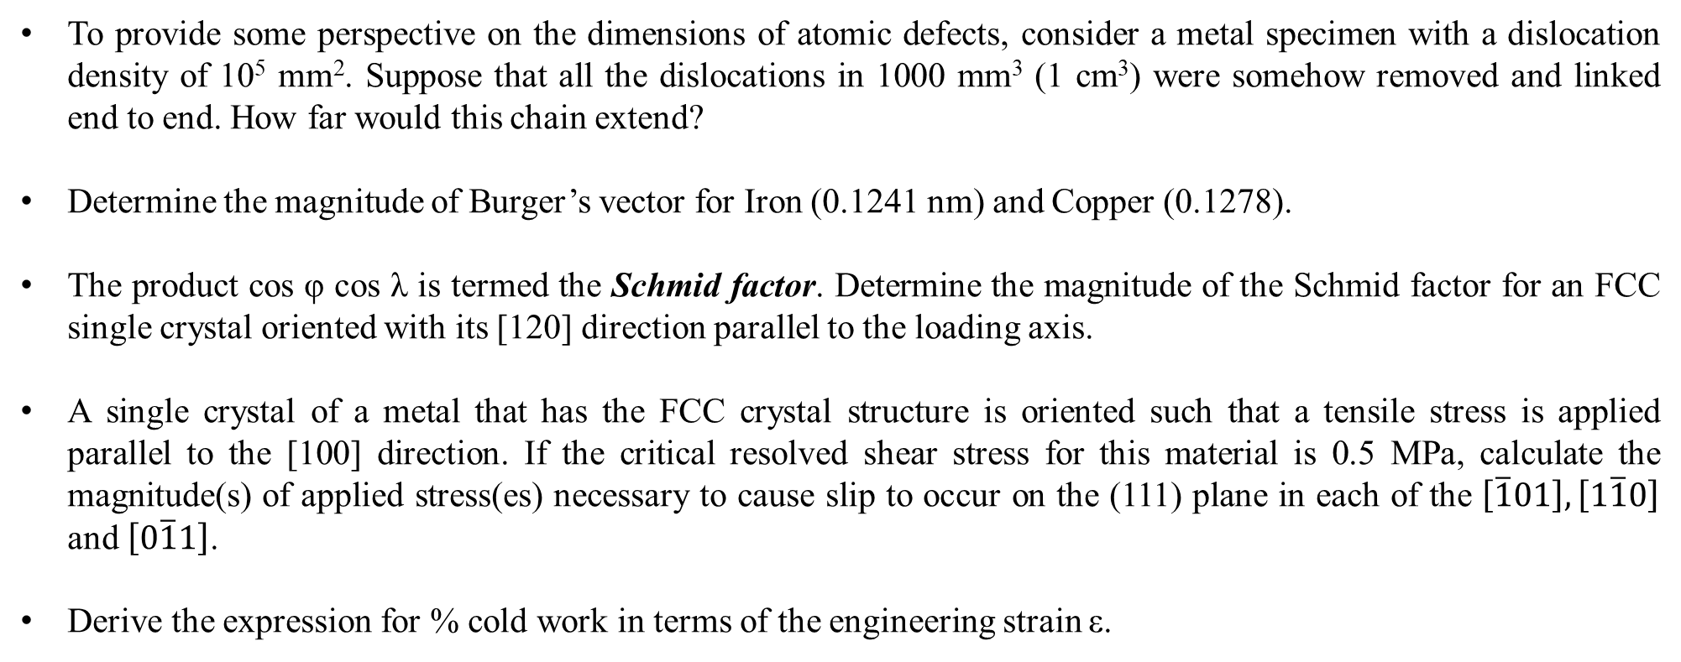
A Mechanism for “Strengthening Your Concepts” – Answer the following
To provide some perspective on the dimensions of atomic defects, consider a metal specimen with a dislocation density of 10⁵ mm². Suppose that all the dislocations in 1000 mm³ (1 cm³) were somehow removed and linked end to end. How far would this chain extend?
Determine the magnitude of Burger’s vector for Iron (0.1241 nm) and Copper (0.1278).
The product cos φ cos λ is termed the Schmid factor. Determine the magnitude of the Schmid factor for an FCC single crystal oriented with its [120] direction parallel to the loading axis.
A single crystal of a metal that has the FCC crystal structure is oriented such that a tensile stress is applied parallel to the [100] direction. If the critical resolved shear stress for this material is 0.5 MPa, calculate the magnitude(s) of applied stress(es) necessary to cause slip to occur on the (111) plane in each of the $\left[\overline{1}01\right],\left[1\overline{1}0\right]$ and $\left[0\overline{1}1\right]$.
Derive the expression for % cold work in terms of the engineering strain ε.

